Slide 1
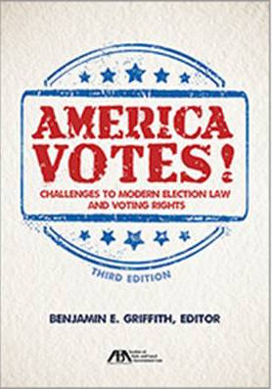
AMERICAN BAR ASSOCIATION WEBINAR October 17, 2016
America Votes! Challenges Facing Modern Election Law & Voting Rights

Slide 2
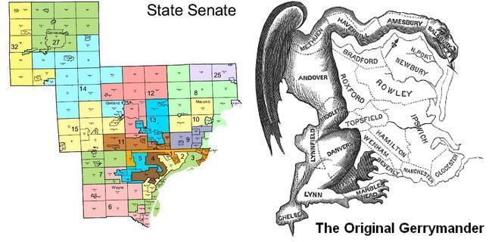
The Role of Race & Partisanship in Redistricting
Benjamin E. Griffith*

Slide 3
Introduction

Slide 4
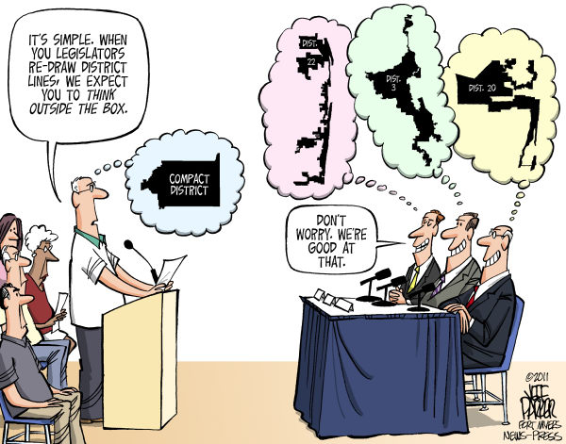

Slide 5
Racial Gerrymandering Claims
The law governing racial gerrymanders has become more clearly established since the Supreme Court’s landmark 1993 decision in Shaw v. Reno. Moreover, the federal courts have been vigilant in their efforts to ensure that the districting process remains free from constitutionally prohibited racial discrimination.

Slide 6
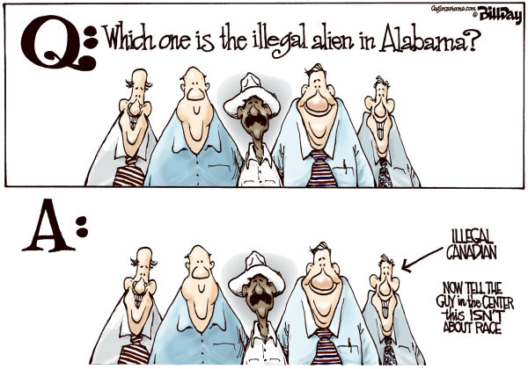

Slide 7
Alabama Legislative Black Caucus
In 2015, the Supreme Court concluded that the Alabama legislature had engaged in racial gerrymandering by packing minority voters into safe majority-minority districts. Minority plaintiffs asserted a justiciable racial gerrymandering claim under the Equal Protection Clause since race was “the predominant factor motivating the legislature's decision to place a significant number of voters within or without a particular district."

Slide 8
The Virginia Litigation: Page and Bethune-Hill
After Alabama Legislative Black Caucus, the Commonwealth of Virginia’s Congressional District 3 was successfully challenged at impermissibly race-based, even though the district had its origin as a Shaw v. Reno remedy.

Slide 9
Confusion over Alabama Legislative Black Caucus
Following the June 2015 decision in Page invalidating Virginia's Third Congressional District on grounds of a Shaw violation, a differently constituted three-judge court in Virginia issued another decision in Bethune-Hill v. Virginia State Board of Elections, 2015 WL 6440332 (E.D. Va. 2015).

Slide 10
Dickson v. Rucho and Harris v. McCrory: North Carolina's Experience
In neighboring North Carolina, that state’s General Assembly adopted the 2011 Congressional Redistricting Plan, after which two groups of plaintiffs filed suits in state court for unconstitutional racial gerrymandering, and another group of plaintiffs filed suit in federal court.

Slide 11
4-4 Division on Pending Cases
A 4-4 decision in any of these cases would mean affirmance of the lower court’s decision that upheld the challenged districting scheme. In light of Justice Scalia’s untimely death in the midst of these and related appeals, some Court observers have predicted that the Court is likely to remain evenly divided for the foreseeable future.

Slide 12
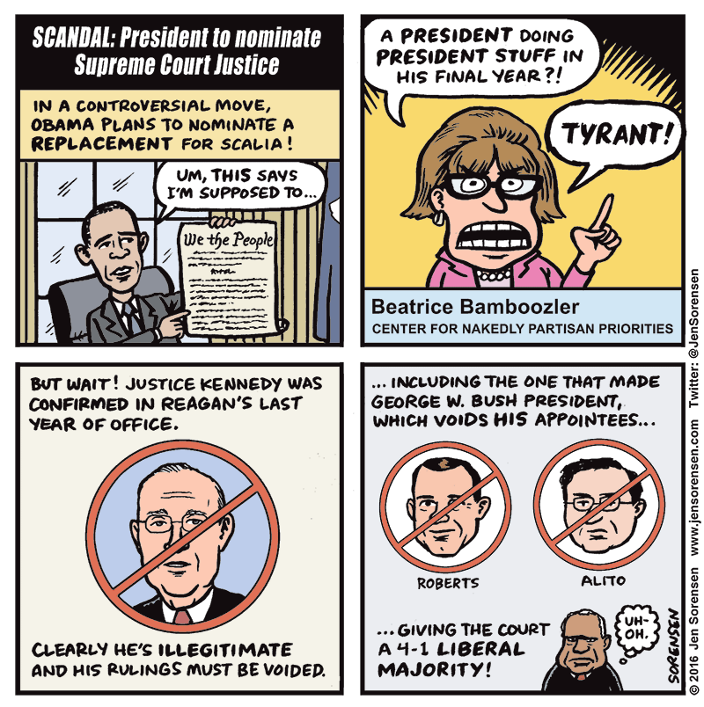

Slide 13
Political Gerrymandering Claims
Political gerrymandering is a different animal altogether. It has been defined as "[t]he practice of dividing a geographical area into electoral districts, often of highly irregular shape, to give one political party an unfair advantage by diluting the opposition's voting strength," Black's Law Dictionary 802, 1346 (10th ed. 2014).

Slide 14
Shift to First Amendment Framework
While the Supreme Court has not been able to agree on a standard for adjudicating political gerrymandering claims brought under the Equal Protection Clause, the lower courts have begun cobbling together the separate opinions, concurrences and dissents from Bandemer, Vieth and LULAC to provide a framework for an Article III court to adjudicate a claim that the State's abuse of political considerations in districting has violated any other constitutional provision.

Slide 15
CONCLUSION
We may be moving toward a resolution of this impasse after November 8, 2016.

